Slide 1
cHat application : a java-based chat application
Project Supervisor:
Md. Martuza Ahamad
Dept. of cse ,
Bsmrstu
Submitted By:
Mokadderul Islam
Id:18cse075
Dept. of cse, bsmrstu

Slide 2
Introduction
The purpose of this project is to develop a chat application using Java socket programming. Socket programming allows communication between two or more devices over a network. In this project, we will implement a server-client model where the server acts as a central hub, and client can connect to it to send and receive messages.

Slide 3
What is Chatting?
On the Internet , Chatting is talking to other people who are using the internet at the same time you are.
In some cases , a private chat can be arranged between two parties who meet initially in a group chat.

Slide 4
What is Chat Application ?
Chat Application is primarily meant based group chat to refer to direct one-on-one chat or text. DVS Technologies provide both type of chat application. DVS Technologies chat application facilitates real-time communication, with its superior feature set and unprecedented reliability. DVS Technologies chat application increases the efficiency of the communication process.

Slide 5
What Is a Socket?
Definition: A socket is one endpoint of a two-way communication link between two programs running on the network. A socket is bound to a port number so that the TCP layer can identify the application that data is destined to be sent to [4].

Slide 6
Requirements
Java Development Kit (JDK)
IDE (Integrated Development Environment) for Java, such as Eclipse or IntelliJ IDEA
Basic knowledge of Java socket programming concepts

Slide 7
System Architecture
Server: The server component will listen for incoming client connection and manage the communication between client. It will handle the following tasks:
Accept client connections and create a separate thread for each client.
Receive messages from client and broadcast them to all connected clients.
Handle client disconnections.
Client: The client component will establish a connection with the server and allow the user to send and receive messages. It will perform the following functions:
Connect to the server using the server's IP address and port number.
Send messages to the server.
Receive messages from the server.

Slide 8
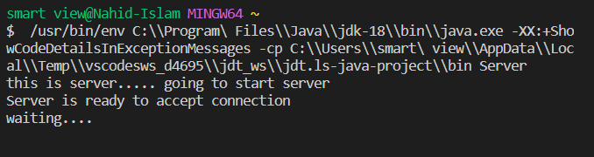
Ready to accept client connections and create a separate thread for client.

Slide 9
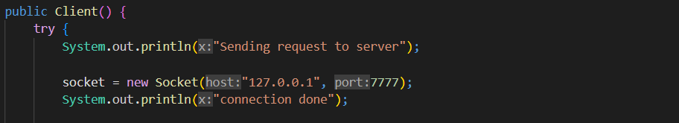
Connect to the server using the server's IP address and port number.

Slide 10
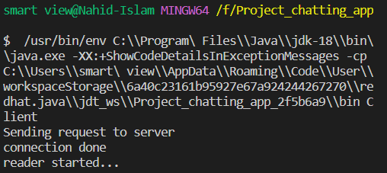
Connect to the server using the server's IP address and port number.

Slide 11
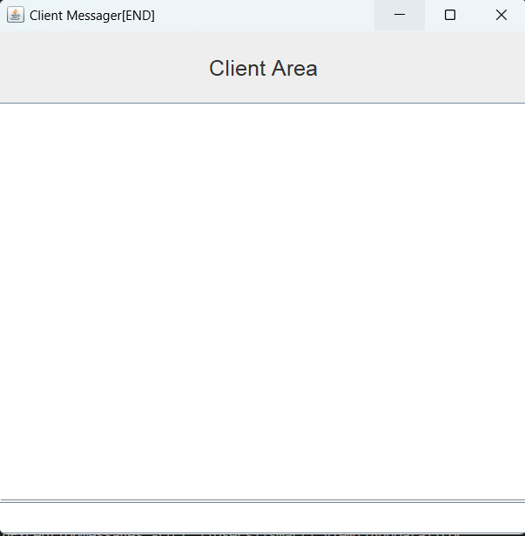
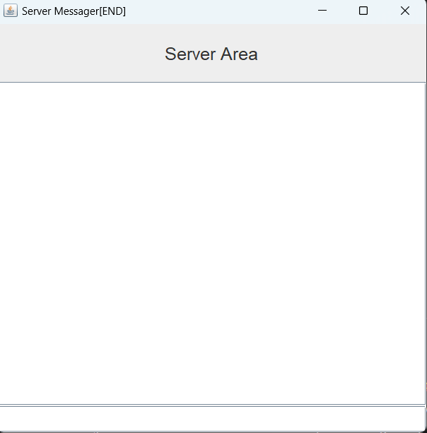
User Interface

Slide 12
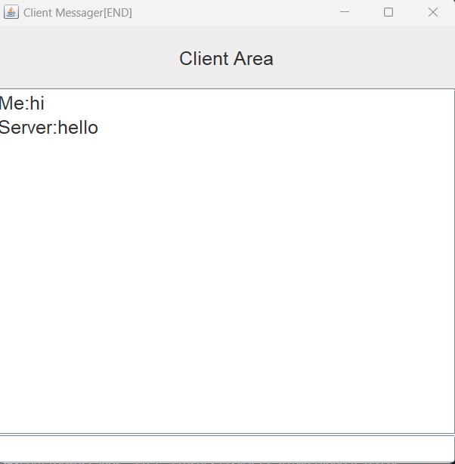
Sent text from both end

Slide 13
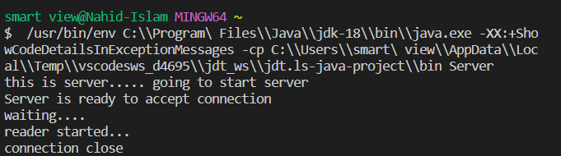
Termination

Slide 14
Implementation
Step 1: Set up the Serve
Step 2: Set up the Client
Step 3: Communication
Step 4: Termination and Error Handling

Slide 15
Conclusion
In this project, we have successfully implemented a chat application using Java socket programming. The server-client model allows client to connect and exchange messages through a central server. This project demonstrates the fundamental concepts of socket programming and provides a foundation for building more complex networked applications.

Slide 16
Future Enhancements
Implement user authentication and secure communication using encryption.
Implement additional features like file sharing or group chat functionality.

Slide 17
Q&A
Thank you for your attention.
Now, I'm open to any questions you may have.

